Slide 1
BULBS, CORMS, AND TUBERS, OH MY!
(and your little Rhizomes, too)
Presented By
Mary L. Dumars
Advanced Master Gardener

Slide 2
Bulbs for Louisiana Gardens
Bulbs for full sun to part sun:
agapanthus, alpinia, belamcanda, canna, crinum, crocosmia, curcuma, dahlia, dietes, eucomis, garlic chives (Allium tuberosum), gladiolus, gloriosa lily, habranthus, hymenocallis, iris (bearded, Siberian), lilies (especially the Philippine lily), oxalis, tigridia, society garlic (Tulbaghia violacea), zephyranthes.

Slide 3
Bulbs for Louisiana Gardens
Bulbs for part shade to shade:
Arum italicum, achimenes, alpinia, bletilla, caladium, crinum, costus, curcuma, globba, hedychium, hymenocallis, kaempferia, oxalis, walking iris (Neomarica).

Slide 4
True Bulbs
round shape with fleshy layers or leaves around a shortened stem
Tulips, daffodils, narcissi, jonquils, hyacinths, Dutch iris, and snowflakes, amaryllis, lilies, alliums
Note: tulips require refrigeration 45-60 days and are annuals in this region

Slide 5
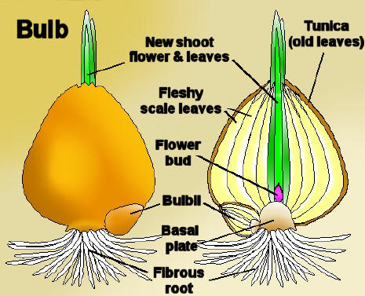
True Bulb Anatomy
This Photo by Unknown Author is licensed under CC BY-SA

Slide 6
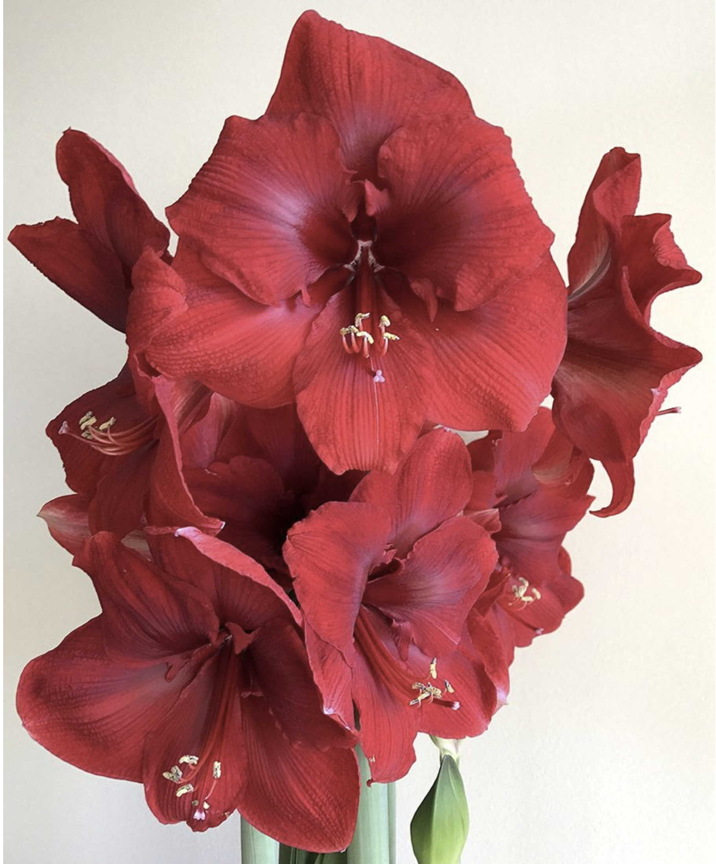
Examples of Bulbs
Notes:
Flower Record Daffodil, Schubertii Allium, Miracle Amaryllis

Slide 7
Corms
Solid bulb-like structure
New corm sits on old desiccated one
Replaces self every year
Crocus, gladiolas, tuberous begonias

Slide 8
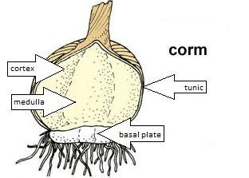
Corm Anatomy

Slide 9
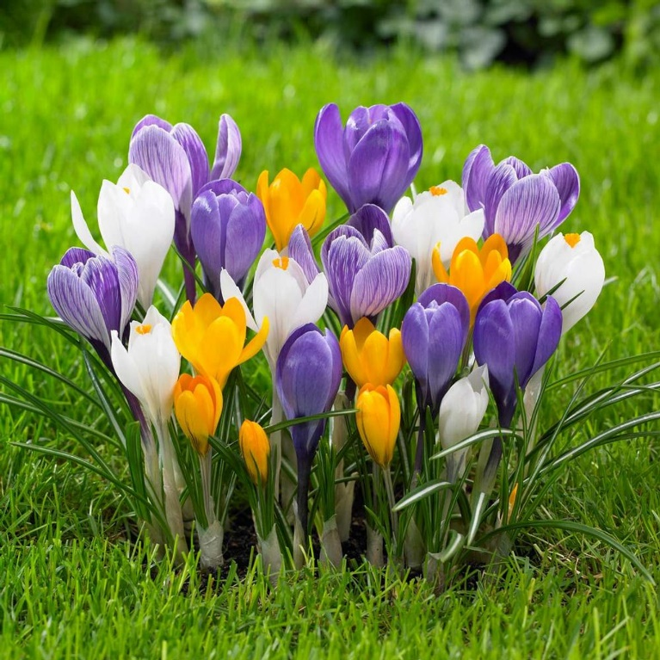
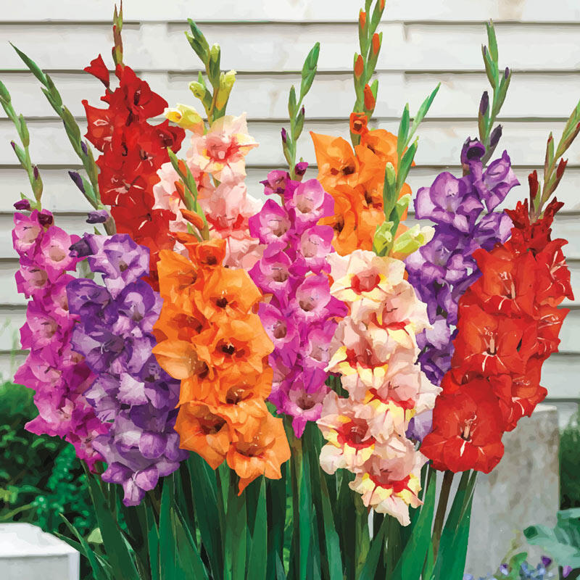
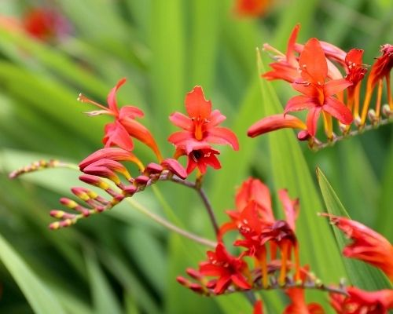
Examples of Corms
Notes:
Crocus, gladiolus, crocosmia

Slide 10
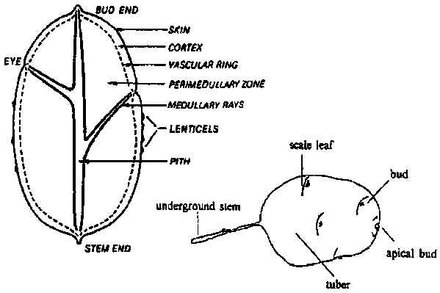
Tubers
Think potatoes, with multiple eye buds
Irregular shape with multiple shoots
Cyclamen, dahlia, peonies, caladiums

Slide 11
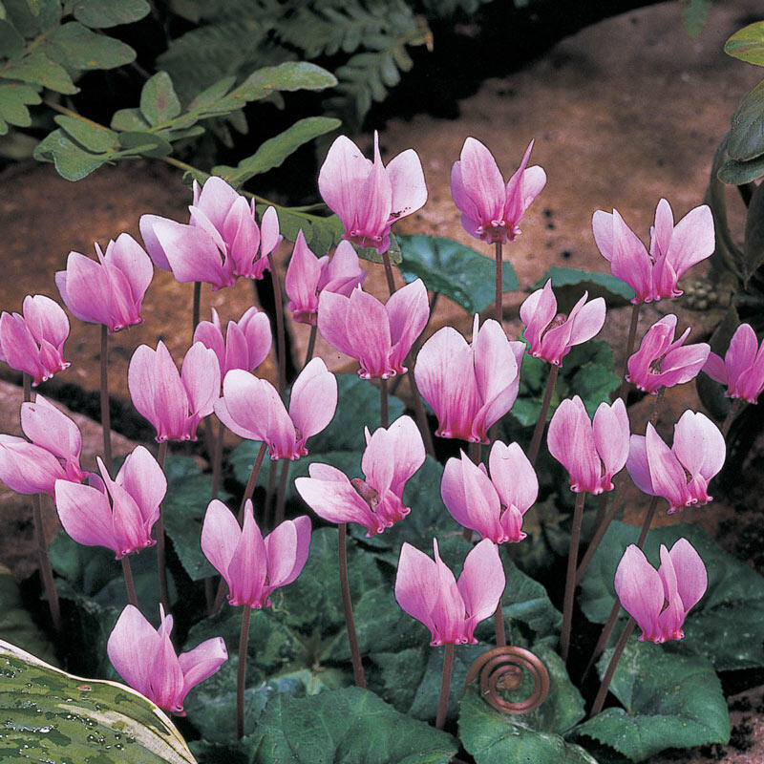
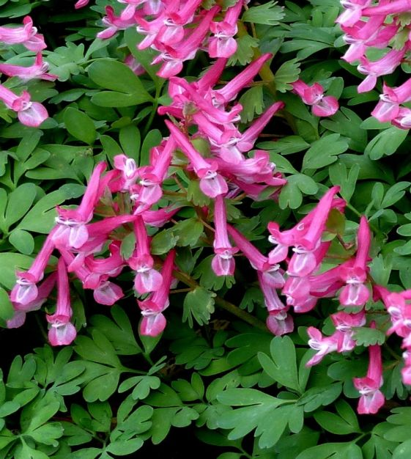
Examples of Tubers
Notes:
Cyclamen, Sorbet peony, Beth Evans corydalis

Slide 12
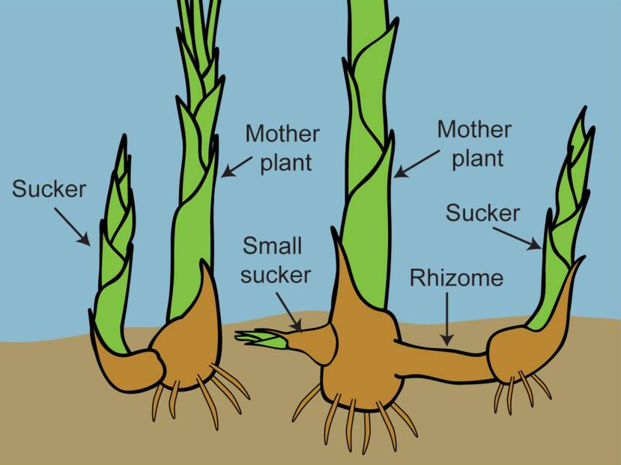
Rhizomes
Grow fleshy stems horizontally
Lily of the Valley, Louisiana iris, canna lily, Bearded iris, ginger

Slide 13
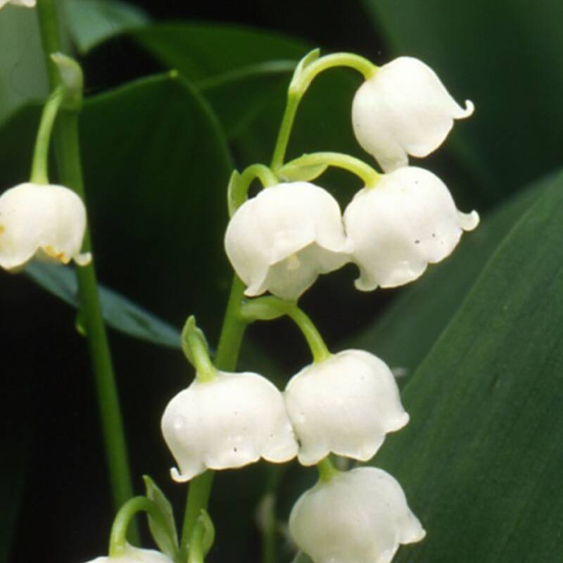
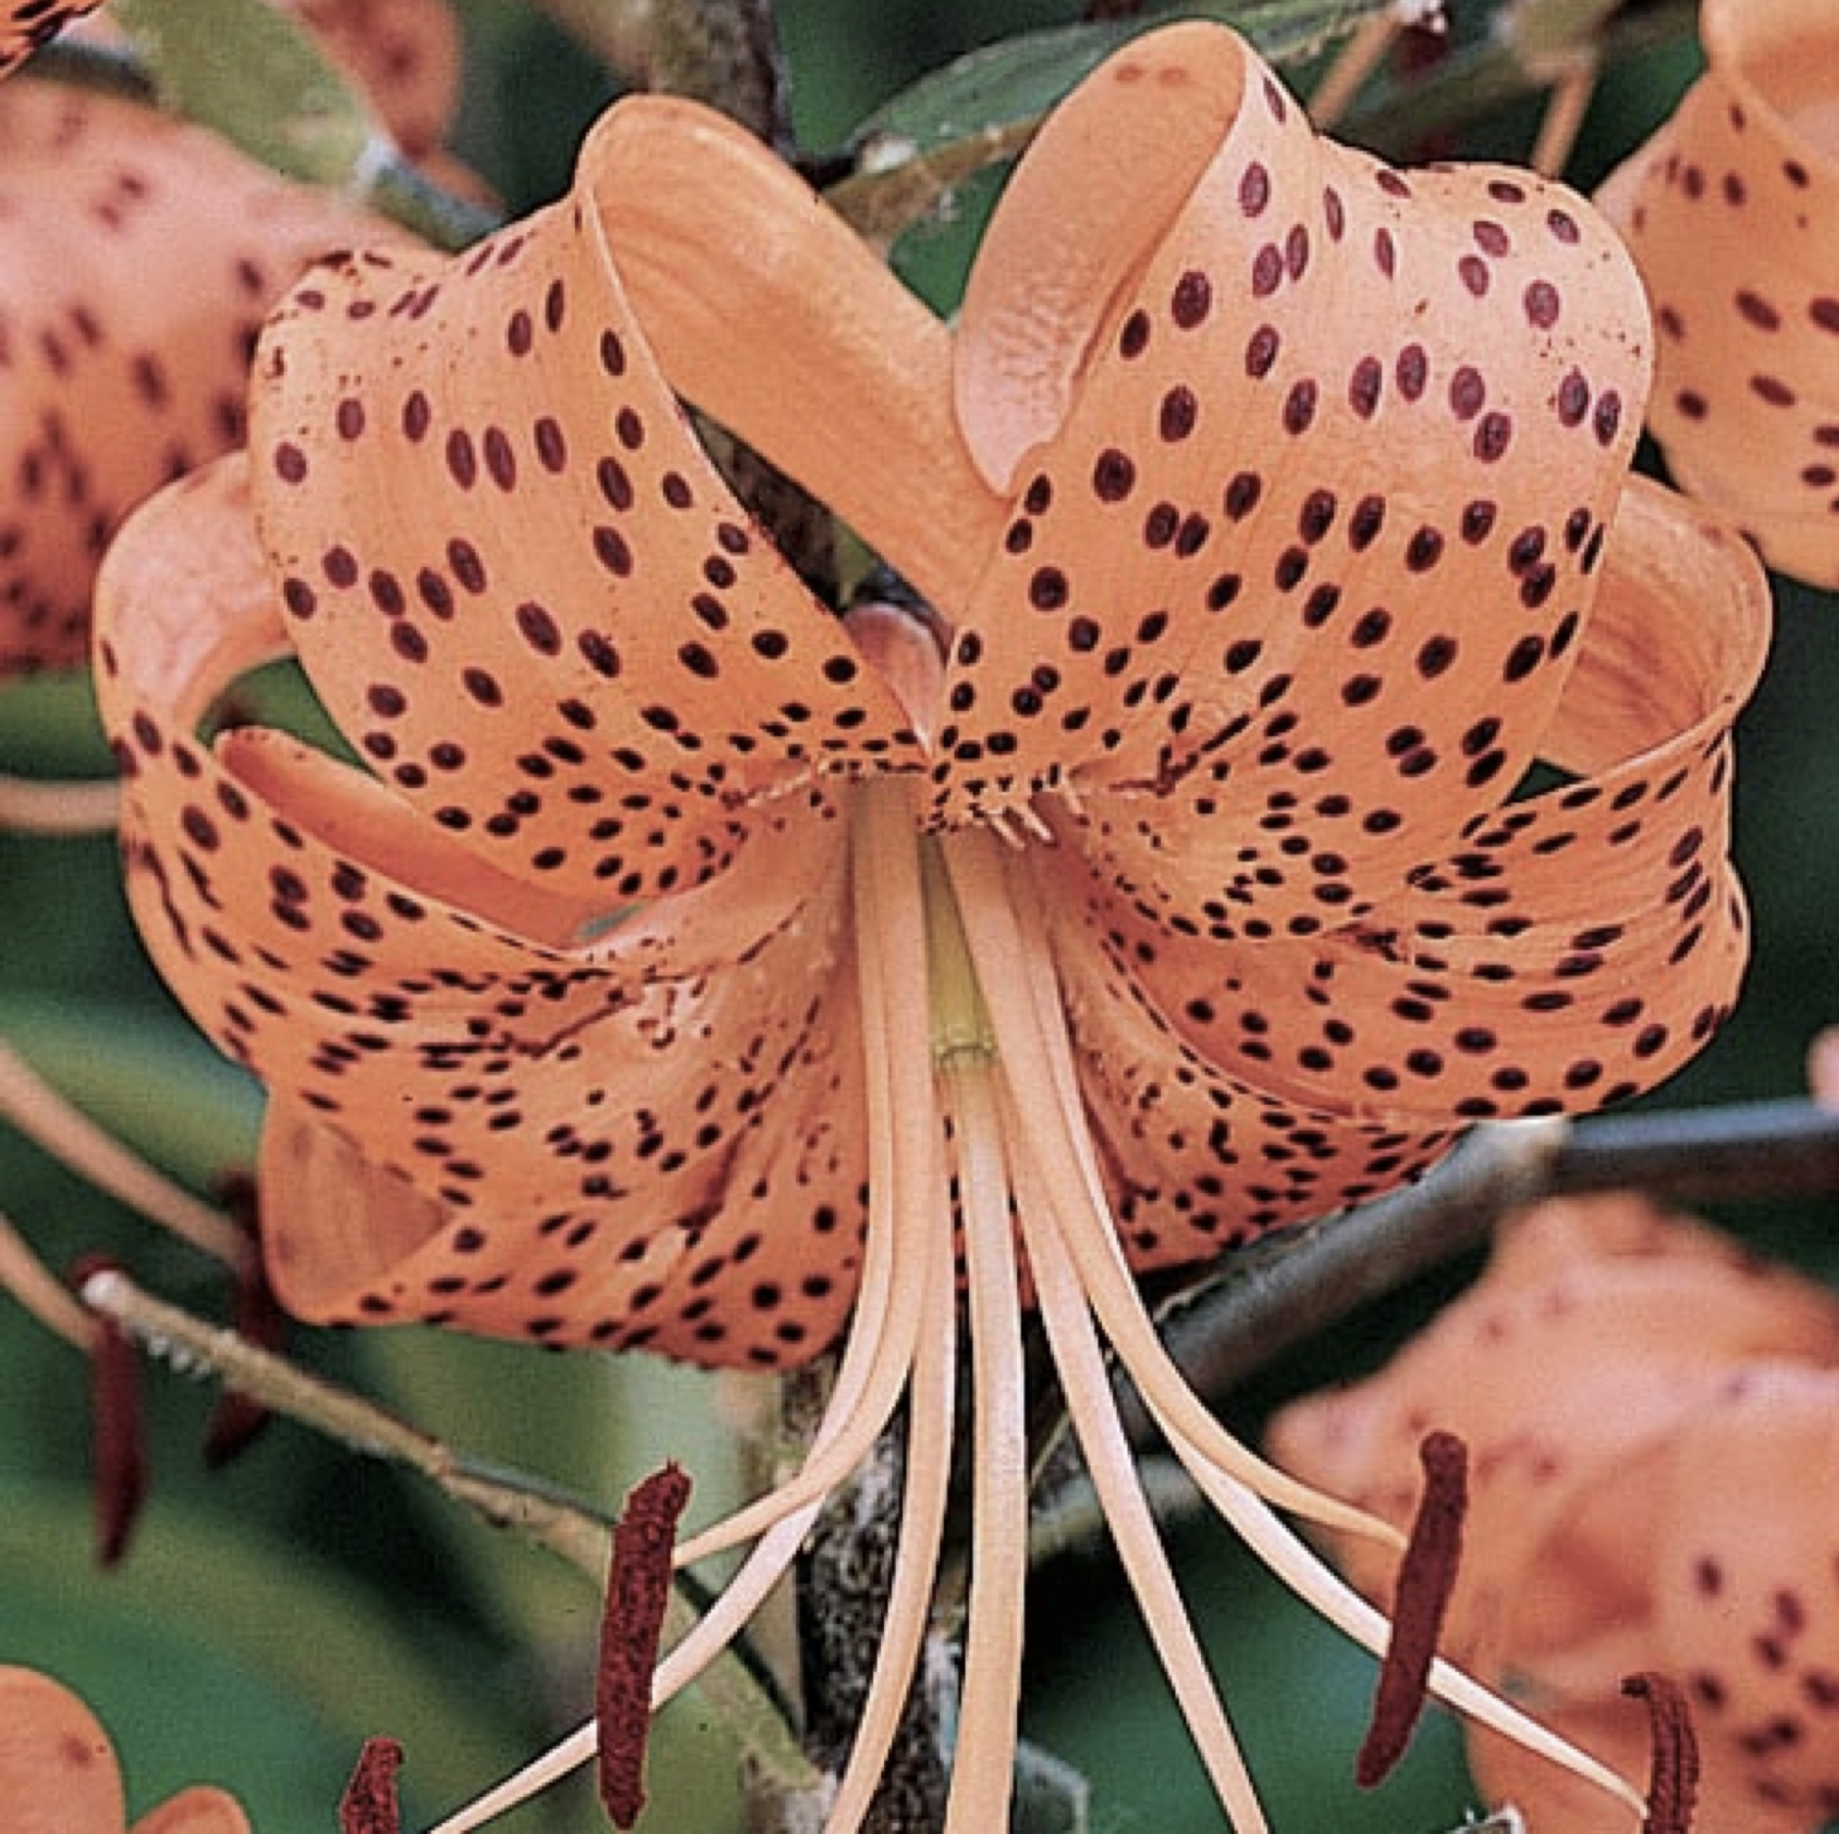
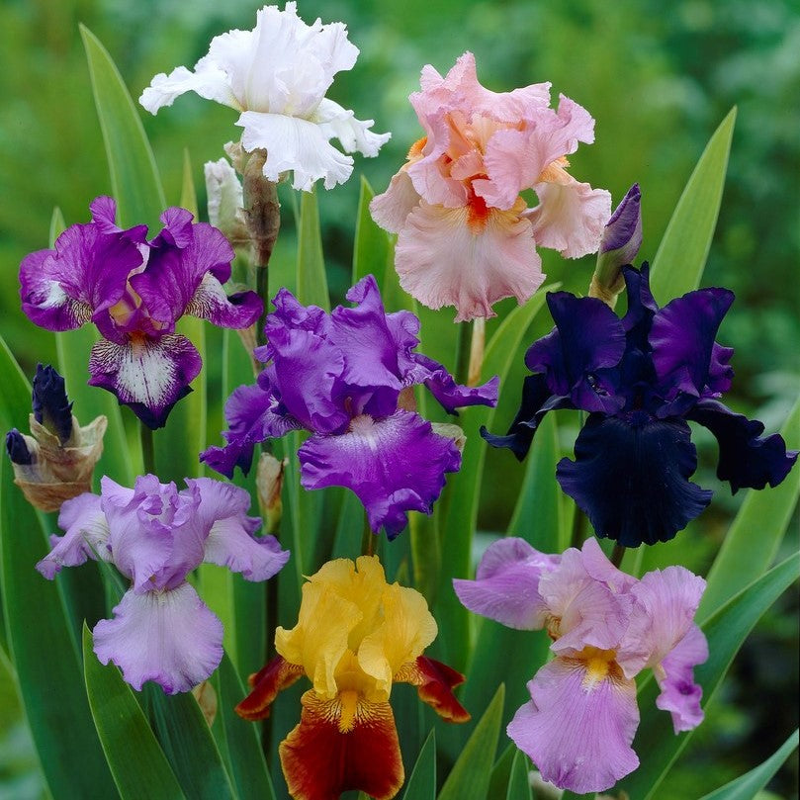
Examples of Rhizomes
Notes:
Lily of the valley, Tiger lily, bearded iris

Slide 14
Planting and Care
Plant to a depth twice the bulb’s height
Soil must be well drained to prevent rot
Water in spring season
Let bulb plant leaves wither and brown before cutting to replenish the bulb
Mark the location of planted bulbs
Bedding flowers can be planted over bulbs

Slide 15
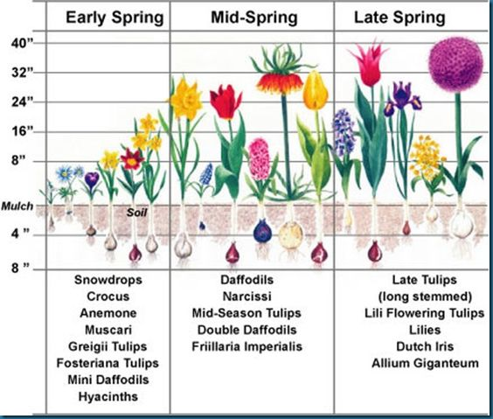

Slide 16
Go Grow Something!
Thank you!

